Slide 1
Powershell
Matthias van den Elsacker
Xavier Clinquart
Notes:
Xavier en Matthias

Slide 2
Getting to know each other
Who am I?
Matthias van den Elsacker
Matthias.vandenElsacker@axxes.com
Working with Axxes since May 2014
System Engineer @ Umicore

Slide 3
Getting to know each other
Who am I?
Xavier Clinquart
Xavier.Clinquart@axxes.com
Working with Axxes since December 2014
System Engineer @ Jan De Nul
Who are you?
Prior experience with Powershell?

Slide 4
Survey
Please fill out the survey at the end of the presentation:
https://forms.office.com/Pages/ResponsePage.aspx?id=tsPR7Ye-u0OS1HqRHFzuFxuX3eVGfXtFoOzIyh2dgltUOERVRjU3RFZZM0NDU0VFWDBNUUhEMFpSNy4u

Slide 5
1. Introduction
Why Powershell?
Notes:
Matthias

Slide 6
Life without powershell
GUIs
Ease of use…
But slow.
Creating 1 user in Active Directory: 5 minutes.
Creating 100 users in Active Directory: 500 minutes?!

Slide 7
Life without powershell
VBScript
Deprecated.
Can’t do everything.
“The last mile”.

Slide 8
Life with Powershell
Microsoft: 100% functionality in the shell.
GUIs are built on top of Powershell
Exchange 2007+, Sharepoint 2010+, SSCM, Office365,…
Windows Server 2012 with Powershell v3.0
“Your choice is learn Powershell, or would you like fries with that?”
Open source! PowerShell Core runs on Mac OS and Linux.

Slide 9
2. Meet Powershell
Scripting environments
Notes:
Matthias

Slide 10
Choose your weapon
Windows PowerShell (Console)
CLI
Windows PowerShell ISE
GUI
Visual Studio Community, Visual Studio Code, Notepad++,…
IDE

Slide 11


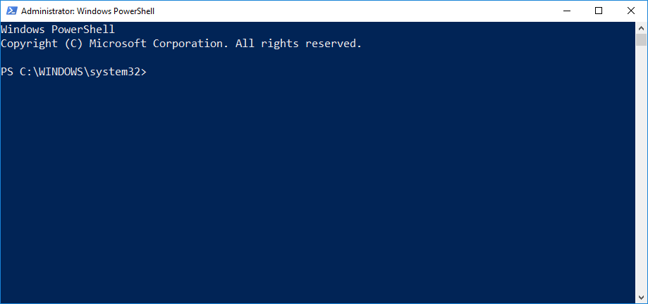
The console Window
No non-English characters.
No default clipboard operations.
No intellisense, only tab completion.
Although much improvement in PS v5.
Good for quick commands.

Slide 12
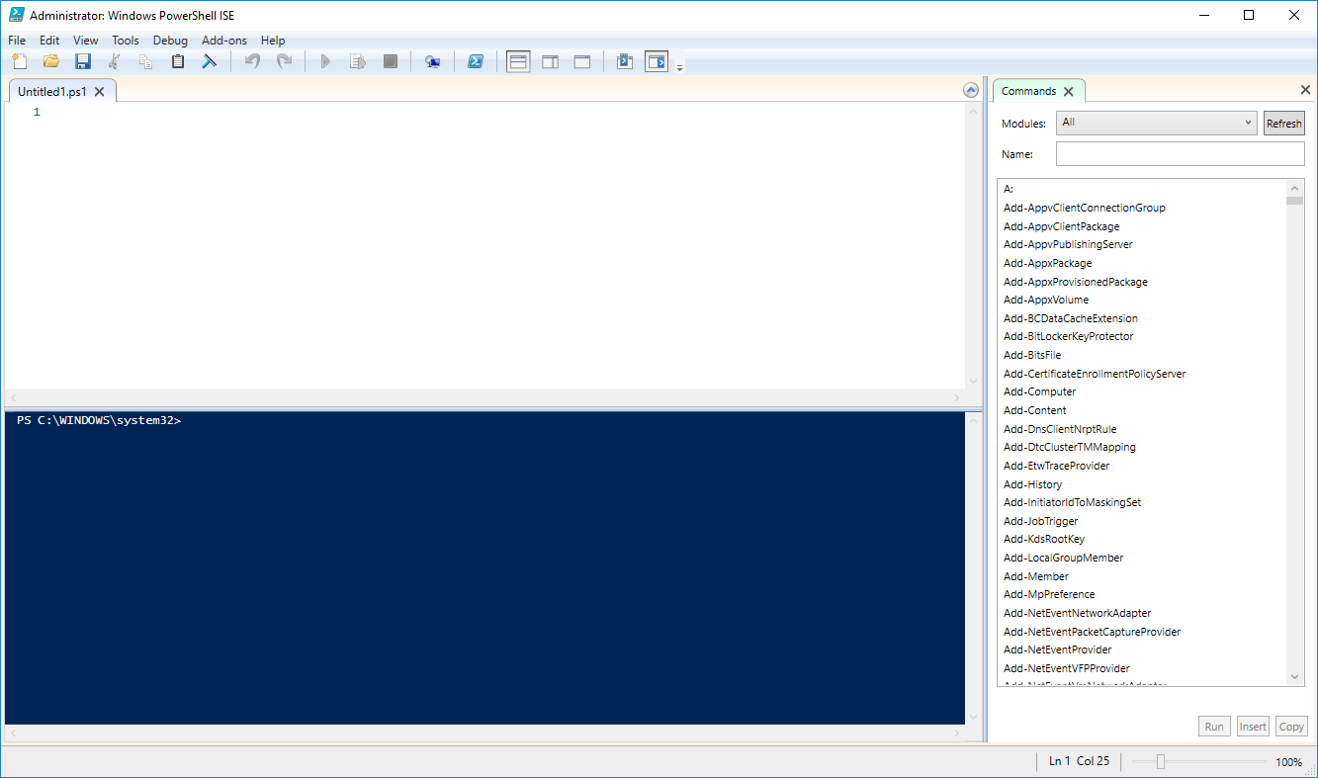
The Integrated Scripting Environment (ISE)
Nicer to look at.
Intellisense and tab completion.
CTRL-C, CTRL-V work!
Requires WPF
So, not on Server.
Heavier footprint.
Good for scripting.
Will be deprecated in the future!

Slide 13
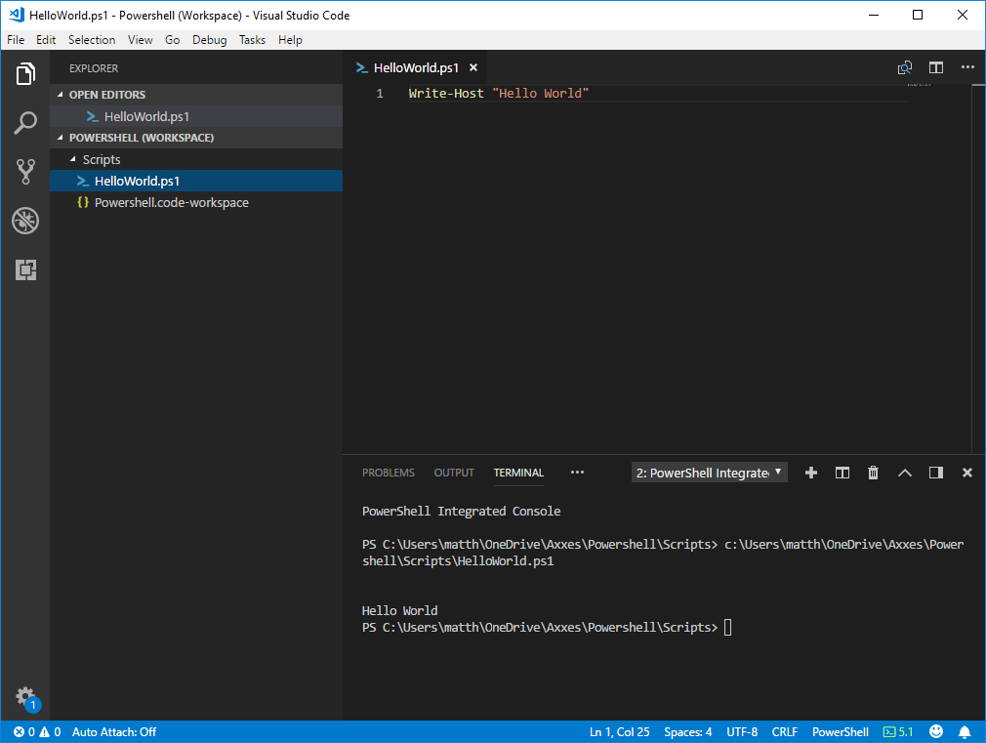
Visual Studio Code
Open source IDE by Microsoft.
Tons of plugins, including Powershell.
Great intellisense.
GIT support.
Multiple files and workspaces.
Mac OS X and Linux.
Good for larger projects.

Slide 14
Tab Completion and Intellisense
Tab completion:
Type Get-S in the CMD and press TAB.
Type Dir C:\ and press TAB.
IntelliSense:
Tab completion, but with a nice dropdown menu.
Notes:
Get-Service
Dir C:\

Slide 15
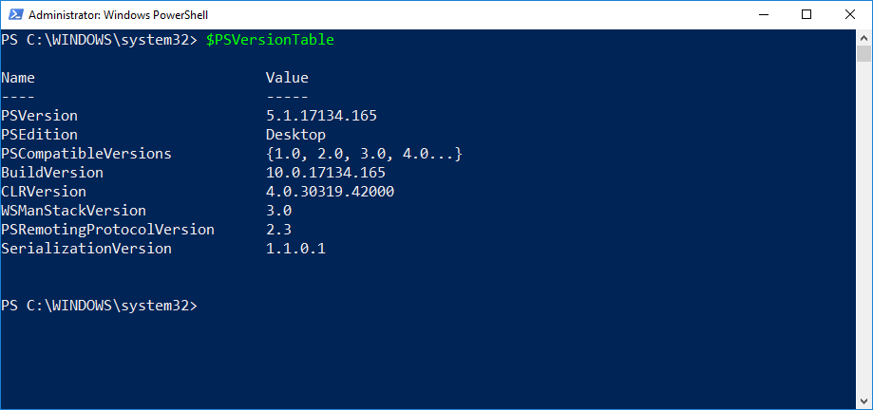
What version am I running?
Notes:
$PSVersionTable

Slide 16
3. Using the help system
RTFM
Notes:
Xavier

Slide 17
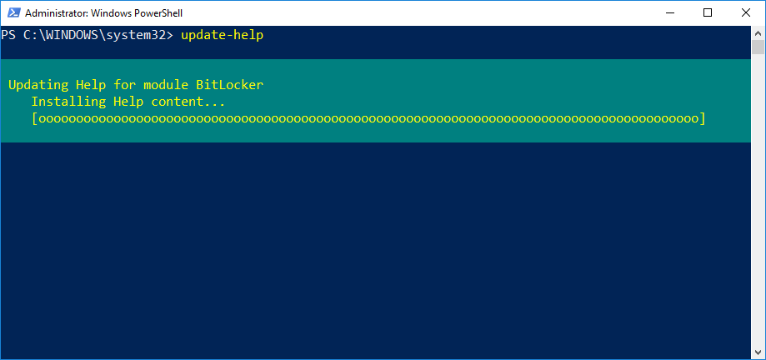
Updatable Help
No help is shipped with Powershell.
Run Update-Help as Administrator.
First thing you should do on a new PC.

Slide 18
Get some help
“Get-Help”
Alias: “Man” or “Help”
“Help” is equivalent to “Get-Help | More”
Spacebar to read more.
CTRL-C (Break) to stop reading.

Slide 19
Using Help to find commands
Get-Help
Positional parameter: -Name.
Accepts wildcards.
Example: Help *log*, Help *event*, Help *event*log*
Get-Help searches through Help files.
Get-Command searches through cmdlets.
Notes:
Get-Help *log*
Help Get-EventLog

Slide 20
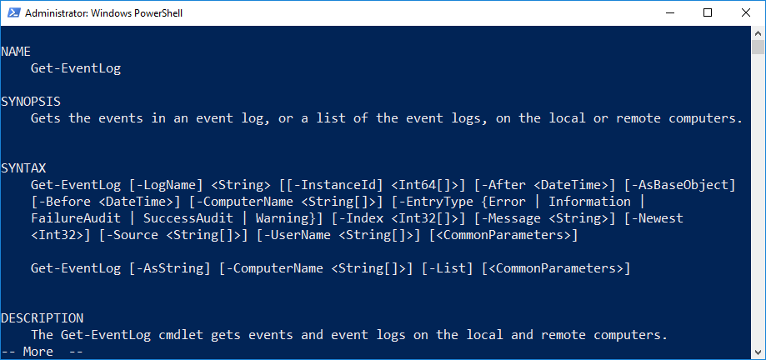
Interpreting the help
Syntax
Multiple syntaxes, multiple parameter sets.
Mutually exclusive.
Optional parameters.
Mandatory parameters.
Positional parameters.

Slide 21
Optional and Mandatory parameters
Optional parameter in square brackets.
[-ComputerName <String[]>]
Mandatory parameters not in square brackets.
[-LogName] <String>
Will be prompted for if you do not specify.

Slide 22
Positional Parameters
Commonly used parameters.
Not required to type them out.
Example: [-LogName] <String> [[-InstanceID] <Int64[]>]
-LogName is not optional, no square brackets surrounding both name and value.
-LogName is surrounded by square brackets, making it positional.
-InstanceID is optional, both name and value surrounded by square brackets.
-InstanceID is positional, because it is surrounded by square brackets.

Slide 23
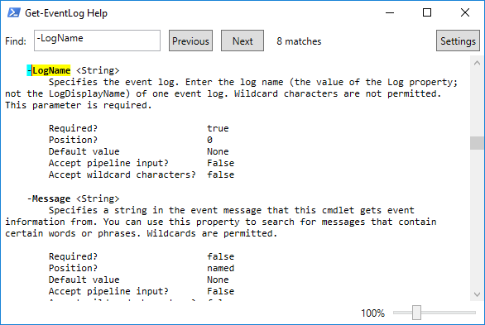
Full Help
Append –Full parameter to Help command.
Example: Help Get-EventLog –Full
For maximum readability: -ShowWindow
Example Help Get-EventLog -ShowWindow
Notes:
Help Get-EventLog -ShowWindow

Slide 24
Parameter values
Switchparameter
Requires no input value. Example: -AsString.
Never positional.
Always optional.
Other parameters require an input value.
Example: [-LogName] <String>

Slide 25
Common types of input
String
Letters and numbers.
Must be contained in “quotation marks” if it has spaces.
Int, Int32, Int64
Integers
DateTime
Date, or time, or both.
Depends on the computer regional settings.
[ ]
Example: String[], Int[]
Array or List of Strings, Integers,…

Slide 26
Finding examples
Use the –Example parameter.
Example: Help Get-EventLog –Example
The –Full parameter will also list examples.
Not all documentation contains examples.
But most do.

Slide 27
Online help
Use the –online parameter.
Opens your default web browser.
On the correct page even!
Microsoft Docs are actually good now.
SS64.com/ps/
Google, Bing, DuckDuckGo, StackOverflow,…
For the brave: https://github.com/PowerShell/
Notes:
Get-Help Get-EventLog -Online

Slide 28
Lab

Slide 29
4. Running commands
Still not scripting
Notes:
Xavier

Slide 30
Powershell, emphasis shell
Powershell is similar to cmd.exe, MS-DOS, or Bash (UNIX).
Powershell is easy.
Type a command, add parameters, press enter. Results!
90% of all people use Powershell like this.
But Powershell can be as complex as you want.
Save some commands to a text file: Now you have a script.
Expose the underlying .NET Framework and start OO programming.

Slide 31
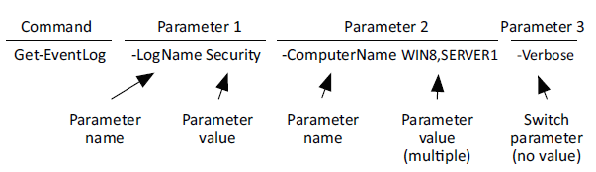
The anatomy of a command
Command
Name: Get-EventLog
Paramter 1
Name: -LogName
Value: Security
Parameter 2
Name: -ComputerName
Values: WIN8, SERVER1
Parameter 3
Name: -Verbose

Slide 32
The anatomy of a command
Always follow the form Verb-Noun.
Mandatory space between the command name and first parameter.
Parameter names always start with a dash (-)
Mandatory space between parameter name, value, and next parameter.
No space between the dash (-) and parameter name.
Nothing is ever case-sensitive.

Slide 33
The verb-noun convention
Established and followed by Microsoft.
Not enforced, but a decent IDE will give a warning.
Standard verbs.
Get, Set, New,…
Get-Verb for a full list. About 10 are common.
Nouns are not standardized.
Makes everyone’s life easier.
Notes:
Get-Verb

Slide 34
Aliases
Alias: short nickname for a command.
Example: You may type “gsv” instead of “Get-Service”.
Find aliases with Get-Alias
Example: Get-Alias –Definition Get-Services
Works with Help as well
Example: Help gsv returns the help file for Get-Service
Create your own alias with New-Alias
(But please don’t use these in scripts. A good IDE will flag them as warning.)
Notes:
Get-Alias

Slide 35
Taking shortcuts
Truncate commands
-Comp works just as well as –ComputerName.
But –Com won’t work if both –ComputerName and –Composite are parameters.
Positional parameters
No need to type them, but respect the order.
Try to avoid them when sharing your scripts though.
Show-Command (but that’s cheating).
Notes:
Show-Command Get-EventLog

Slide 36
External commands support
Windows cmdlets are built-in.
You can add Exchange, SharePoint, AD,… Modules
Native CMD.exe commands work as well.
Ping, nslookup, dir, net,…
However, some have a Powershell equivalent.
Example: Test-Connection vs Ping.
May need some tweaking, especially with parameters.

Slide 37
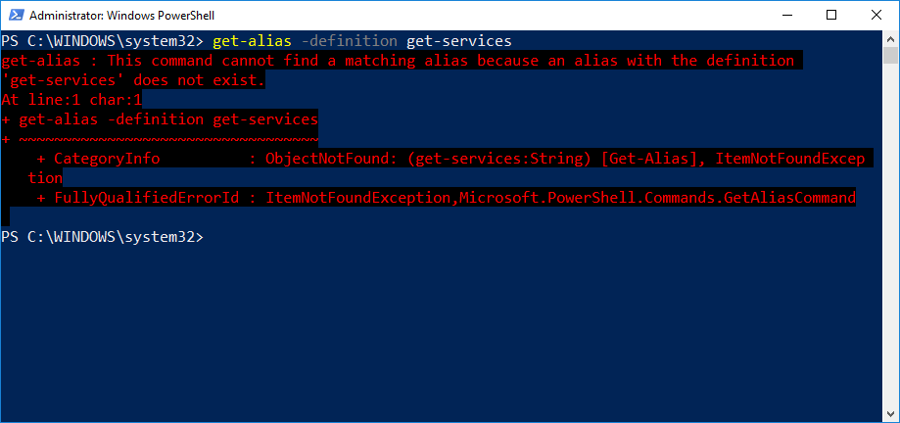
Dealing with errors
Menacing looking red text.
But always helpful.
Also works in ISE.
Helpful for debugging long scripts.
Tells you on what line and char.

Slide 38
Lab

Slide 39
5. Working with providers
Is this a disk drive?
Notes:
Matthias

Slide 40
Providers?
PSProvider acts like an adapter.
Takes some kind of data storage, make it look like a disk drive.
Get-PSProvider for a list.
Each PSProvider has certain capabilities.
ShouldProcess: Supports –Whatif and –Confirm parameters.
Filter: Provides the –Filter parameter.
Credentials: Allows for the –Credential parameter.
Transactions: Rollback or Commit support.
Notes:
Get-PSProvider
cd HKCU:
cd Software
dir

Slide 41
PSDrive
You use a provider to create a PSDrive.
A PSDrive uses a provider to connect to data storage.
Creates drive mapping, but much more than disks.
Get-PSDrive
FileSystem: A, C, D,…
Alias
Registry: HKCU, HKLM
…
The PSProvider adopts the data store, the PSDrive makes it accessible.
Notes:
Get-PSDrive
cd cert:
cd localmachine
cd ca
dir

Slide 42
The filesystem
Hierarchy: Drive.
Folder: container.
File: endpoint object.
Powershell refers to “items” for both files and folders.
Items can have child items.
Items have Properties (last modify date, size…)

Slide 43
Navigating the filesystem
Set-Location
Example: Set-Location –Path C:\Windows\Temp
Alias: cd
Equivalent to cd command in cmd.exe
New-Item
File; Folder; Registry Key? Item is generic, so needs to be specified.
“mkdir” is a function that automatically appends –Type Directory to New-Item.

Slide 44
Wildcards in Items
Most of the “item” cmdlets include the –Path property.
Wildcards are allowed here.
Example: Get-item –Path C:\*.exe
But what about Registry? * and $ are valid key names.
-LiteralPath does not interpreted special characters as wildcards.
-LiteralPath is not positional.
Notes:
cd HKCU:
cd Software
New-Item "ad*"
Get-Item "ad*"
Get-Item -LiteralPath "ad*"

Slide 45
Working with other providers
Registry is the most known besides Filesystems.
Set-Location to navigate
Example: Set-Location –Path HKCU:
Set-ItemProperty to change registry key values.
Example: Set-ItemProperty –Path somepath –PSProperty somekey –Value somevalue
Additional providers exist for IIS, SQL Server, Active Directory,…

Slide 46
Lab

Slide 47
6. The pipeline
One symbol to rule them all: |
Notes:
Matthias

Slide 48
Connecting one command to another
The pipeline passes (pipes) the output of one command.
And uses this as input for another command.
UNIX shells have known this concept for long.
Example: Get-Process | Export-CSV process.csv
Gets an overview of all running processes.
Instead of displaying it in the shell, feed it to Export-CSV to create a CSV file.
This works with nearly every Get-… cmdlet.
Reverse: Import-CSV process.csv
Notes:
Get-Process | Export-CSV process.csv
Import-CSV process.csv

Slide 49
Piping to a file or printer
In cmd.exe: dir > directorylist.txt
PS equivalent: dir | Out-File directorylist.txt
Out-Printer: Immediately prints to the default printer.
Out-GridView: Opens a GUI with the data.
Out-Null, Out-String,…
ConvertTo-HTML: Converts to HTML.
BUT: Does not export to a file! Pipe it again for output.
Get-Service | ConvertTo-HTML | Out-File services.html
Notes:
Get-Process | Out-GridView
Get-Service | ConvertTo-Html | Out-file services.html

Slide 50
Piping can be dangerous
Get-Process | Stop-Process
This kills the computer.
Filtering is important
Get-Process –Name Notepad | Stop-Process
Every Cmdlet has an internal Impact Level.
$ConfirmPreference is a local setting.
When the internal impact level >= $ConfirmPreference: “Are you sure?”
Force “Are you sure?” with –Confirm.
Similar safe-guard: -WhatIf
Notes:
notepad.exe
Get-Process -name notepad | Stop-Process
Get-Process | Stop-Process -WhatIf

Slide 51
Lab

Slide 52
7. Adding commands
Powershell is more fun with friends
Notes:
Matthias

Slide 53
How one shell can do everything
Think about the MMC console
Limited functionality in itself.
Add snap-in: DHCP, Active Directory, Event Viewer,…
Import-Module ActiveDirectory
Available by default on Domain Controllers.
Can be installed on a client computer with RSAT.

Slide 54
Finding and adding snap-ins
PSSnapins are used less and less
Replaced by Modules
Get-PSSnapin -Registered
Add-PSSnapin
Get-Command -PSSnapin

Slide 55
Finding and adding Modules
Powershell V2 and higher.
Easier to distribute.
Does not require advanced registration.
PSModulePath environment variable.
Modules located here are automatically loaded.
Get-Content env:\PSModulePath
Not modified via PowerShell, but via System Variables in Control Panel.
Loaded Modules provide tab completion and IntelliSense.
Import-Module for manual import.
Notes:
Get-Content Env:\PSModulePath

Slide 56
Profile scripts
Preload extensions when the shell starts.
Saves you from typing at the start of each session.
Export-Console C:\MyShell.psc
Powershell.exe -PSConsoleFile C:\MyShell.psc
Modules are not included.
Profile script
C:\Users\Documents\WindowsPowerShell
profile.ps1
Runs automatically when opening the shell.

Slide 57
Getting modules from the internet
PowerShell Gallery
http://powershellgallery.com
Community-contributed.
NuGet (like Linux)
Register-PSRepository
Find-Module, Install-Module, Update-Module
Notes:
Register-PSRepository -Default
Find-Module Tesla

Slide 58
Lab

Slide 59
8. Objects
It’s just data, really
Notes:
Matthias

Slide 60
What are objects?
Example: Get-Process
Shows a “list” of process objects in table form.
A lot more information is available than shown.
Get-Process | ConvertTo-HTML | Out-File processes.html
Terminology
Object: “Row” in our table. A single “thing”.
Property: “Column” in our table. Piece of information from that “thing”.
Method: An action that can be taken in the “thing”. Example: Kill process.
Collection: Our entire “table”. Set of all objects.

Slide 61
Why objects?
Comes from the underlying OO-programming language .NET
Easier and more intuitive to work with than XML, csv,…
More power and flexibility.

Slide 62
Discovering objects
Powershell only shows you a portion of the table.
Get-Member
Alias: gm.
Used in the pipe.
Example: Get-Process | gm
Shows both Methods, Properties, and others.
Notes:
Get-Process | Get-Member

Slide 63
Using object Methods
Example: Stopping a Process
Using the Pipe:
Get-Process -Name Notepad | Stop-Process
Using a single command:
Stop-Process -Name Notepad
Using a method:
(Get-Process -Name Notepad).Kill()

Slide 64
Sorting Objects
Every cmdlet has a default “sorting”.
Example: Get-Process is alphabetical by ProcessName.
Sort-Object
Example: Get-Process | Sort-Object -Property Id
Descending or Ascending
Alias: Sort
Get-Process | Sort ID,VM -desc

Slide 65
Being selective
Select-Object
Able to select exactly what you want to see.
Example: Get-Process | Select-Object -Property ProcessName,ID,VM
Reminder: You can pipe as much as you want
Example: Get-Process | Select ProcessName,ID,VM -First 100 | Sort VM,ID,ProcessName | ConvertTo-HTML | Out-File Processes.html
Object goes in, Object goes out.
But the Object can “transform” a bit along the way down the pipe.
Notes:
Get-Process | Select-Object -Property ProcessName,ID,VM
Get-Process | Select-Object -Property ProcessName,ID,VM | Sort-Object ID

Slide 66
Lab

Slide 67
9. Formatting
Making it look good
Notes:
Xavier

Slide 68
Default formatting
Implicit Out-Default at the end of each command.
Powershell parses dotnettypes.format.ps1xml in the $pshome folder.
This file contains the formatting “rules”.
If not found in this file: Types.ps1xml.
Formatting “lies”.
Example: Get-Process shows a PM(K) column.
There is no PM(K) property, only PM.
So don’t assume anything based on column headers. Get-Member never lies.
Notes:
cd $PSHOME
DotNetTypes.Format.ps1xml

Slide 69
Formatting tables
Format-Table
Alias: FT
-AutoSize
Sizes columns, based on contents.
-Property
Specify the properties to be shown.
Wildcard: *. But shows only what fits!
Example: Get-Process | Format-Table -Property * -AutoSize
Notes:
Get-Process | Format-Table -Property * -AutoSize

Slide 70
Formatting Tables
-GroupBy
Groups table by certain property.
Example: Get-Service | Sort-Object Status | Format-Table -groupBy Status
-Wrap
Will truncate text that is too long to fit with (…)
Notes:
Get-Service | Sort-Object Status | Format-Table -groupBy Status

Slide 71
Formatting Lists
Format-List
Alias: FL
Same properties as Format-Table
Special case: Format-List *
Displays properties and values for an object.
Notes:
Get-Service | Format-List *

Slide 72
Formatting wide lists
Format-Wide
Mix of FL and FT.
Only values of a single property.
-Property
Only one.
No wildcards.
-Colums to specify more columns.
Notes:
get-service | format-wide -Column 4

Slide 73
Custom columns and list entries
Example: Get-Service | Format-Table @{name=‘ServiceName’;expression={$_.Name}},Status,DisplayName
Take the ‘Name’ Property and display it as ‘ServiceName’ in the column header.
Advanced example: Get-Process | Format-Table Name,@{name=‘VM (MB)’;expression={$_.VM / 1MB -as [int]}} -AutoSize
Take the ‘VM’ property, do some arithmetic to convert it to MB, and display it as ‘VM (MB)’ in the column header.
Notes:
Get-Process | Format-Table Name,@{name=‘VM (MB)’;expression={$_.VM / 1MB -as [int]}} -AutoSize

Slide 74
Going out
Out-File or Out-Printer after formatting.
Could still look slightly different because of font and character width.
Experimenting is key.
Out-GridView
Not technically formatting.
But very handy and immediately looks neat without effort.
Only usable when ISE is installed. (Windows Only).

Slide 75
Format Right
Most important rule when formatting.
Format- cmdlet should always be the last thing on the command line.
Out-File or Out-Printer as only exception.
The reason is implicit Out-Default | Out-Host at the end.
Only these Out- cmdlets know how to handle Format instructions.
Don’t feed multiple cmdlets to one pipe.
Example: Get-Process;Get-Service will mix FT and FL.

Slide 76
Lab

Slide 77
10.Filtering and Comparing
Why can’t I hold all this data
Notes:
Xavier

Slide 78
filtering
Early Filtering: Apply filters as soon as possible.
Most cmdlets have some form of early filtering built-in.
Example: Get-Service -Name e*,s*
-Filter parameter
Example: Get-ADComputer -Filter “Name -like ‘*DC’”
This is called filtering left.
Notes:
Get-Service -Name e*,s*

Slide 79
Filtering left
Filtering left is the most efficient.
Cmdlets further down the pipe will have less data to deal with.
Downside: Every cmdlet has its own filtering abilities.
Example: Get-Services only allows filtering on Name.
Example: Get-ADComputer allows filtering on Computer object attributes.
When built-in filtering is not sufficient: Where-Object.
Alias: Where

Slide 80
Comparison operators
Think programming languages.
Every comparison results in True or False.
-eq: Equal. Example: 5 -eq 5 equals True. “hello” -eq “help” equals False.
-ne: Not equal.
-ge,-le: Greater than or equal to, less than or equal to.
-gt,-lt: Greater than, less than.

Slide 81
Comparison operators
-and, -or makes combinations.
Example: (5 -gt 10) -and (10 -gt 100) is False.
Example: (5 -gt 10) -or (10 -lt 100) is True.
-not reverses the result.
Example: -not (5 -lt 10) equals False.
In PowerShell: $True and $False.
Example: $_.Responding -eq $False

Slide 82
Comparison operators
-like: For comparing strings. Accepts wildcards.
Example: “Hello” -like “*ll*” equals True.
Reverse: -notlike.
-clike and -cnotlike for case-sensitive comparison.
-match: For matching regular expressions.
Reverse: -notmatch.

Slide 83
Filtering out the pipeline
Where-Object
Generic filtering cmdlet.
Example: Get-Service | Where-Object -Filter {$_.Status -eq ‘Running’}
-Filter is positional.
$_ is a placeholder for the current object.
Access properties with ‘.’.
Example: $_.Status.
Only valid in special cases, like in the pipeline.
Notes:
Get-Service | Where-Object {$_.Status -eq "Running"}

Slide 84
Multiple pipes and filtering
Get-Service -computername (Get-Content c:\names.txt | Where-Object -Filter { $_ -notlike ‘*dc’ }) | Where-Object -Filter { $_.Status -eq ‘Running’}

Slide 85
Lab

Slide 86
11. Remote control
We are legion
Notes:
Matthias

Slide 87
-Computername
-Computername is a parameter.
Get-Service, and some others, have this.
Gets services from a remote computer.
The vast majority of commands does not natively “support” this.
Solution: Remoting!

Slide 88
The idea behind remote Powershell
Think Telnet.
The command actually runs on the remote computer.
Only the results make it back to yours.
Protocol: Web Services for Management (WS-MAN)
Operates over HTTP(S), so easy firewall configuration.
Microsoft’s implementation of WS-MAN: Windows Remote Management (WinRM)
Installed by default.
Enabled by default on Server OS 2012+

Slide 89
The idea behind remote Powershell
PowerShell cmdlets produce Objects.
These are serialized and transmitted as XML files.
On your computer, the XML file deserializes into an Object.
But: these object are static “snapshots”.
Example: You can’t tell a service to stop via remoting.
But there are ways to overcome this limitation.

Slide 90
Enabling WinRM
Powershell: Enable-PSRemoting.
CMD: winrm quickconfig.
Running this in a “Public” network will fail.
Needs to be Home or Work.
Can be enabled via GPO in a domain as well.
TCP ports 5985 (HTTP) and 5986 (HTTPS) by default.

Slide 91
One-to-One remoting
Accessing a shell of a single computer.
Kind of like RPD, but for the CLI.
Enter-PSSession -Computername ServerName.
The shell will change: [ServerName] PS C:\>
Indicating successful connection.
No object serialization. All objects are “live”.
Exit-PSSession.

Slide 92
One-to-many remoting
Invoke-Command
Example: Invoke-Command -Computername R1,R2,R3,R4 -Command { Get-EventLog Security -Newest 200 | Where { $_.EventID -eq 1212}}
Everything in the -Command {brackets} gets executed on the remote computer.
-Command is actually an alias for -ScriptBlock.
Powershell processes 32 computers at once. More get queued.
-ThrottleLimit parameter to increase this.

Slide 93
Good to know
Remoting works on computer name only. No DNS alias or IP address.
Invoke-Command runs one command at a time.
The session opens, the ScriptBlock is executed, and the sessions closes.
PowerShell needs to run as administrator.
Mind the firewall.
GPO overrides local policies!

Slide 94
Lab

Slide 95
12. Security
Or how to prevent global cyberwarfare
Notes:
Matthias

Slide 96
Keeping the Shell secure
VBScript and WSH
Early scripting languages.
Leaky buckets.
Point of entry for many viruses: I Love You, Melissa,…
PowerShell
Trustworthy Computing Initiative
Security experts closely involved with the project.
As secure as can be.

Slide 97
Powershell security goals
No additional layers of permissions.
You can only do what you are allowed to do.
Example: New-ADUser will not work for your account without AD rights.
Unable to bypass existing permissions.
“Works on my PC”.
Giving a script to users does not mean those users have enough rights to run it.
No defense against malware.
Goal: prevent users from unintentionally running scripts or commands.

Slide 98
Execution policy
Default policy: Restricted.
You can not run any scripts by default.
Get-ExecutionPolicy
Set-ExecutionPolicy
Can be set via GPO.
Can be set per command with -ExecutionPolicy parameter.
This overrides local settings and GPO.

Slide 99
Execution policies
Restricted: Default. No scripts can be executed.
Except when signed by Microsoft.
AllSigned: All scripts that are signed by a trusted CA.
RemoteSigned: Local scripts can run, remote scripts need to be signed.
This includes scripts downloaded from the internet.
Unrestricted: Every script is allowed to run.
Bypass: “I got this. Don’t worry about it.”

Slide 100
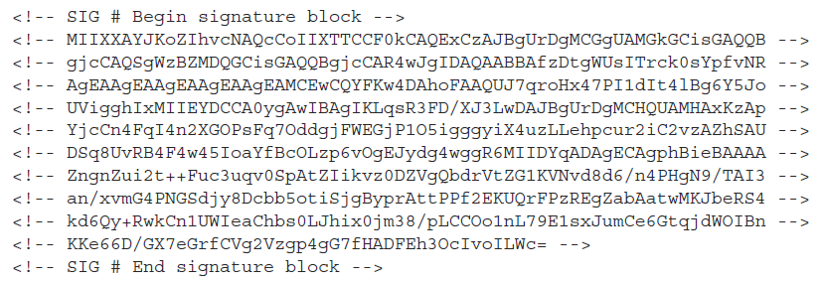
Code signing
Cryptographic signature.
At the end of the file.
List identity of who signed the script.
Includes encrypted copy of the script.
Code-signing certificate needed to sign.
Via trusted CA like GoDaddy.
Via company PKI

Slide 101
Code signing
Certificate needs to be trusted to run signed scripts.
Set-AuthenticationcodeSignature
Adds digital signature to a script.
Help about_signing
New-SelfSignedCertificate to create your own certificate.
IDEs usually do this for you automatically.
Certificates ensure that the script has not been tampered with.

Slide 102
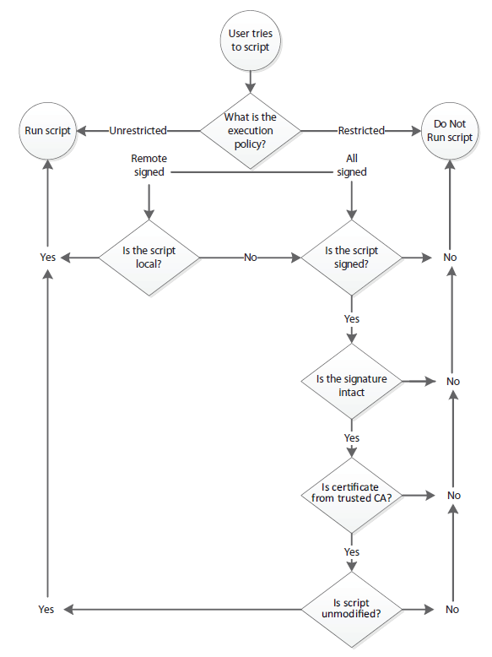
Code signing
Decision tree for running scripts.

Slide 103
Other security measures
.PS1 extension is not executable.
Double clicking opens it in notepad or ISE.
Prevents users from accidentally running scripts.
Scripts can not be run by their name alone.
Example: You have a script called “test.ps1”.
Typing “test” or “test.ps1” will NOT run the script.
Absolute path “C:\test.ps1” or relative path “.\test.ps1” will run.
“.\” in this context means “current directory”.
Prevents “command hijacking”. Example: Naming your script “Dir.ps1”
“Dir” runs the Dir cmdlet. “.\Dir” runs the Dir.ps1 script.

Slide 104
Lab
TODO: Self-Signed certificate

Slide 105
13. Variables
PowerShell's storage closet
Notes:
Xavier

Slide 106
Storing values in variables
$myVar = “Some text”.
$ is PowerShell syntax for “here comes a variable name” or “I want to access this”.
“myVar” is the actual name of the variable.
May contain letters, numbers and underscores.
May have spaces, but need to enclosed in {brackets}
Example: ${My Variable} (But don’t do this.)
Variables are not persistent between shell sessions.
May contain any type of Object such as String, Int,…
Notes:
$myVar = "Hello there"
$myVar = "GENERAL KENOBI"

Slide 107
Quotes and variables
‘Single quotation marks’ are treated by PowerShell as a literal string.
Example: $var = ‘What does $var contain?’
“Double quotes” replaces variables with their values.
Example: $var = “The computer name is $computername”.
Special case: The backtick character `
Example: $var = “`$computername contains $computername”.
Example: $var=“`$computername`ncontains`n$computername”.
Help about_escape
Notes:
$var = "localhost"
'what does $var contain?'
"what does $var contain?"

Slide 108
Storing many objects in a variable
$computers = “server1”,”server2”,”localhost”
Make sure the commas are outside the quotes.
Use [index] to reach individual items.
Example: $computers[0], $computers[-1]
Arrays start at 0.
-1 is the last object, -2 is the second to last,…
$computers.count, $computers[2].toUpper(),…

Slide 109
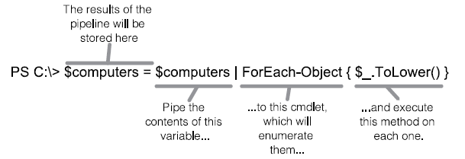
Working with multiple objects
ForEach-Object
“Loop” over every object.

Slide 110
Unrolling properties
$services = Get-Service
$services.Name
Won’t work. Or will it? Starting from PowerShell v3
“Automatic unrolling” of properties and methods.
Under the hood: Get-Service | ForEach-Object {Write-Output $_.Name}
Or: Get-Service | Select-Object -ExpandProperty Name

Slide 111
Subexpressions
$services = Get-Service
$firstname = “$services[0].name”
$firstname does not contain what you expect.
[ is not a valid character in a variable name. PowerShell jams every name into the string.
Instead: $firstname = “$($services[0].name)”
This only works in double quotes!
Notes:
$services = get-services
$firstname = "$services[0].Name"
$firstname
$firstname = "$($services[0].Name)"

Slide 112
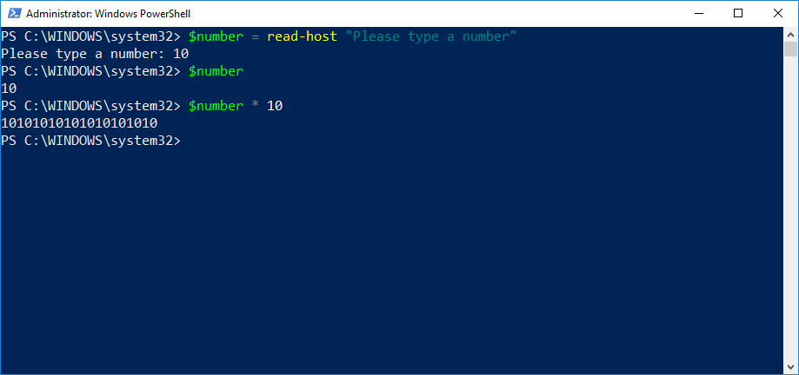
Declaring types
10 * 10 = 10101010…?
The input is a String.
* means “duplicate” for a String.
Verify with $number | gm.
Resolution: [int]$number
“Casting”.
Notes:
$int = Read-Host "Please give a number"
$int * 10
$int | gm
$int = [int]$int
$int * 10
$int | gm

Slide 113
Types
[int]: Integers
[single] and [double]: Decimals with single and double precision.
[string]: A string of characters.
[char]: A single character.
[xml]: An XML document. [xml]$doc = Get-Content MyXML.xml
[adsi]: Active Directory Service Interfaces query.

Slide 114
Commands for variables
In PowerShell, variables need not be declared. This is automatic. But anyway:
New-Variable
Set-Variable
Remove-Variable
Get-Variable
Clear-Variable

Slide 115
Lab

Slide 116
14. Input and Output
Show and tell
Notes:
Matthias

Slide 117
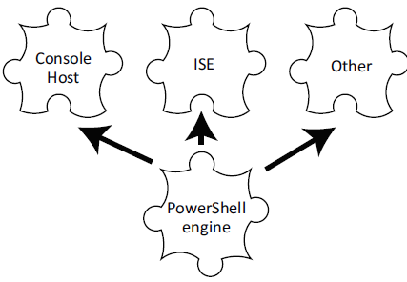
Display information
You interact with the hosting application
ISE
CLI
Other (Visual Studio Code)
Data is passed to the PS Engine.
Results are displayed.
Each host could display differently.

Slide 118
Read-Host
Read-Host “Enter a computer name”
Colon : is automatically added.
Input is placed on the pipeline.
Usually captured in a variable.
ISE will display a .NET InputBox with Powershell V2
But not with Powershell V3

Slide 119
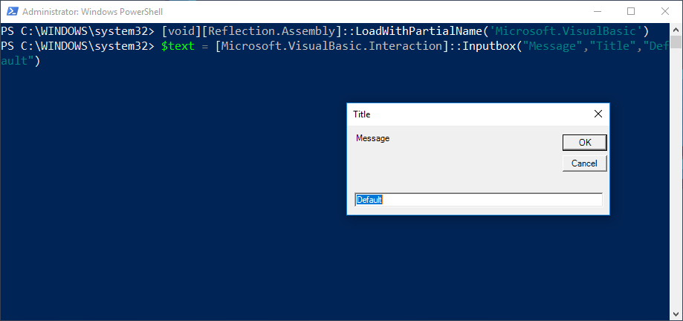
Inputbox
Utilizes underlying .NET Framework.
[void][Reflection.Assembly]::LoadWithPartialName('Microsoft.VisualBasic’)
$text = [Microsoft.VisualBasic.Interaction]::Inputbox("Message","Title","Default")
[void] = “Discard the parsing results.”
Same as Out-Null
Notes:
[void][Reflection.Assembly]::LoadWithPartialName('Microsoft.VisualBasic')
$text = [Microsoft.VisualBasic.Interaction]::Inputbox("Message","Title","Default")
$text

Slide 120
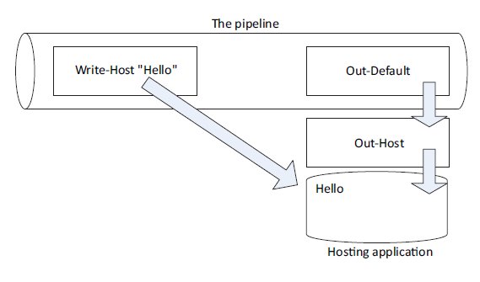
Write-Host
Doesn’t place anything on the pipeline!
Writes directly to the host application.
“Markup options”
-Foregroundcolor
-Backgroundcolor
Not supported by every host.
Output can NOT be captured.
For human interaction only.

Slide 121
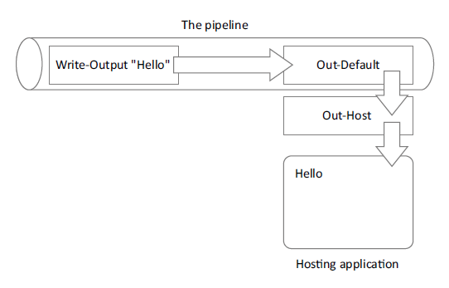
Write-Output
Sends objects to pipeline.
No formatting.
Alias: Write
Why is the output displayed?
Implicit Out-Default at the end.
write-output "Hello" | where-object { $_.length -gt 10 }
write-host "Hello" | where-object { $_.length -gt 10 }
Notes:
write-output "Hello" | where-object { $_.length -gt 10 }
write-host "Hello" | where-object { $_.length -gt 10 }

Slide 122
Other ways to write
Write-Warning
$WarningPreference = Continue (default)
Write-Verbose
$VerbosePreference = SilentlyContiue (default)
Write-Debug
$DebugPreference = SilentlyContinue (default)
Write-Error
$ErrorActionPreference = Continue (default)
Write-Information
Powershell V5 only.

Slide 123
Lab

Slide 124
15. Scripting
This is where the fun begins
Notes:
Matthias

Slide 125
Not programming (per se)
Think batch files.
.bat / .cmd
Simple text files that tell the computer what to do, in what order.
Not programming, batch is extremely limited in that regard.
Powershell scripts are very similar.
But programming is definitely possible.
Can be stupidly simple, or ridiculously complex.

Slide 126
The definition of insanity
“Doing the exact same thing over and over again expecting things to change.”
So don’t keep typing all those commands over and over again.
Type a long, complex script in the ISE.
Save it as a .PS1 file.
Best practice: keep the verb-noun nomenclature.

Slide 127
Parameterizing scripts
Replace anything that could change with a $variable.
Example: Instead of -Computername SERVER1, use -Computername $variable.
Set this variable at the start of your script.
Param at the beginning of your script.
Example: param ( $computername = ‘localhost’ )
‘localhost’ is the default value, making the parameter optional.
Automatically positional.
Use comma (,) for multiple parameters.
Example: param ($computername = ‘localhost’, $id = 1)

Slide 128
Documenting your script
Good practice if you intend to share your script.
Makes the Get-Help cmdlet usable on your script.
Place info at the top between <# #> comments.
.SYNOPSIS
.DESCRIPTION
.PARAMETER 1, PARAMETER 2,…
.EXAMPLE
Some IDEs will offer to do this for you automatically.

Slide 129
One script = One pipeline
In the CLI, each command has its own Pipeline.
Example: Get-Process [Enter] Get-Service
Two pipelines, two separate outputs.
.PS1 scripts have one single pipeline.
Example: Get-Process [newline] Get-Service
Execute script.
One single output from both commands.
Notes:
Get-Process
Get-Service
.\PipelineExample.ps1

Slide 130
Scope
Scripts run within their own scope.
A function in script 1 will not be recognized in script 2.
Global scope exists as long as powershell.exe is running.
Local/script scope exist only when the script runs.
Local scope has precedence over higher scope.
Variables also only exist in their scope.
Notes:
$myVar = "This is a var in the global scope."
$myVar
.\ScopeExample.ps1
$myVar

Slide 131
Lab

Slide 132
16. Active Directory
Managing your ad via PowerShell
Notes:
Xavier

Slide 133
RSAT
Remote Server Administration Tools
Free download from Microsoft
Only needed on Client OS
Server OS has the tools, if you enable Active Directory
Contains the Active Directory PowerShell Module
Windows 7: Download KB, enable, reboot.
Windows 10 1903+: Feature on Demand

Slide 134











Commandlets
Create
Remove
Get
Set
Search
Unlock
Enable
Disable

Slide 135
Main usage
Simplify your work
Add large amounts of accounts
Modify multiple Objects
Generate data reports
Automate daily tasks in AD

Slide 136

Reminder: Combining multiple commandlets
Pipeline
For-each
ForEach-Object

Slide 137
17. Multitasking
Was invented when someone tried doing a task twice
Notes:
Matthias

Slide 138
Make Powershell do multiple things
PowerShell is single-threaded by default.
PowerShell is sequential, aka “Synchronous”.
Type command, press enter, wait for the results, type next command.
Solution: Background jobs. “Asynchronous”.
Every new job spawns a new PowerShell process.

Slide 139
Synchronous vs asynchronous
Synchronous commands respond to input request.
Asynchronous do not.
Synchronous commands produce error messages.
Asynchronous do as well, but you don’t see them immediately.
Synchronous commands prompt for required parameters.
Asynchronous will simply fail.
Synchronous commands display results immediately.
Asynchronous caches them and they need to be retrieved.
Conclusion: Test synchronous first before making asynchronous.

Slide 140
Creating a local job
Start-Job -ScriptBlock.
-Name to name the job.
Optional parameter.
If not specified: Job1, Job2,…
-Credential if needed.
-FilePath instead of ScriptBlock for a script file.

Slide 141
Creating a local job
Jobs are local.
But ScriptBlock commands may still reach out to other computers.
Example: Start-Job -ScriptBlock { Get-EventLog -ComputerName Server1 }

Slide 142
Remoting as a job
Invoke-Command -AsJob
Remoting needs to be enabled on each target computer.
Commands are run on the remote computer.
Example: Invoke-Command -Command {Get-Process} -ComputerName (Get-Content C:\servers.txt) -AsJob -JobName MyProcessJob

Slide 143
Getting job results
Get-Job to list all jobs.
To see more details: Pipe to Format-List.
Receive-Job to get results.
Specify the name of the job. Or simply pipe Get-Job | Receive-Job.
Receiving clears the results from the cache. Use -Keep to prevent this.
Results may be deserialized, so not “live” objects.
Example:
Start-Job { dir } -Name DirJob
Receive-Job -Name DirJob
Notes:
Start-Job {dir} -Name DirJob
Get-Job
Receive-Job DirJob

Slide 144
Getting Job results
Warning: Jobs run in their own context.
So be weary of paths.
Receive-Job from Invoke-Command Job appends PSComputerName property.
To keep track of where the results come from.

Slide 145
Working with child jobs
Every job has one top-level parent and at least one child job.
Get-Job | Format-List
Has property: ChildJobs
Get-Job -Id 1 | Select-Object -Expand ChildJobs
List all child jobs
You can receive results from each individual child job.

Slide 146
Managing Jobs
Remove-Job: Delete a job, including cached results.
Stop-Job: Terminates a job, keeps cached results.
Wait-Job: Forces the shell to halt and wait until a job is complete.

Slide 147
Scheduled jobs
PowerShell’s way of Scheduled Tasks.
New-JobTrigger: Defines when the task will run.
New-ScheduledTaskOptions: Sets various options.
Register-ScheduledJob: Register the job with Task Scheduler.
This creates a folder hierarchy, contain the results each time the job runs.
Example: Register-ScheduledJob -Name DailyProcList -ScriptBlock { Get-Process } -Trigger (New-JobTrigger -Daily -At 2am) -ScheduledJobOption (New-ScheduledJobOption -WakeToRun -RunElevated)

Slide 148
Lab

Slide 149
18. Programming
Taking it one step beyond
Notes:
Matthias

Slide 150
PowerShell = .NET
PowerShell is built on the .NET Framework.
C#.NET, VB.NET are Object-Oriented programming languages.
PowerShell can be (ab)used as OO programming language as well!
You have all the building blocks you need.
Functions, classes, objects, variables, logical structures,…
This can increase the power of your scripts even further.

Slide 151
Functions
A script file (ps1) or module file (psm1) can contain multiple functions.
These do not get executed when running the script.
Only when calling them.
Example: MyFunctions.ps1
Containing MyFunction1, MyFunction2, MyFunction3.
Call MyFunction1 from within this ps1 file, or from somewhere else.

Slide 152
Functions
Syntax: function MyFunction {}
Usually returns something in the end.
Example: return $myvariable.
Return statement ends the function immediately.
Can take parameters, just like scripts.
Example. Param([string]$computername=‘localhost’,[int]$eventID=1)

Slide 153
Logical structures
If (something) { } Elsif (something else) { } Else { }
Example: If ($var1 -gt $var2) { return “$var1”} else { return “$var2”}
For (counter) {}
Example: For ($counter=0;$counter –lt 3;$counter++) { Write-Output “$counter” }
ForEach (object in list) {}
Example: ForEach ($Service in $Services) { Write-Output “$Service.Name”)
Some others: Switch, While,…

Slide 154
Lab

Slide 155
19. Toolmaking and GUIs
Giving users something to look at
Notes:
Matthias

Slide 156
Toolmaking
Fancy name for generally more complex scripts.
“Toolboxes” with various functions.
Main goal: re-usability by fellow admins and helpdesk.
Example: Create contact in Exchange.
Ask for first and last name.
Do everything else automatically and give verbose output.

Slide 157
GUIs
Harness the power of .NET
WPF (Windows Presentation Foundation)
Uses XAML (xml) files to present data.
Code-behind in C# or VB.NET
But in this case: Powershell.
System.Windows.Controls Namespace .NET API
Best created in an IDE like Visual Studio.

Slide 158
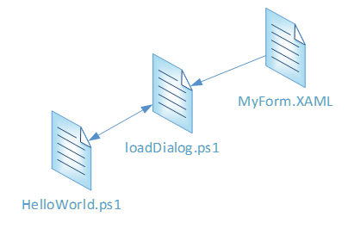
Loading GUIs
Presentation is written in XAML.
loadDialog.ps1 reads this file.
Every XML element is transformed into a Global Powershell object.
These objects are accessible by name from other PS1 scripts.
“MVC” sort of style.
Model, View, Controller are separated.

Slide 159
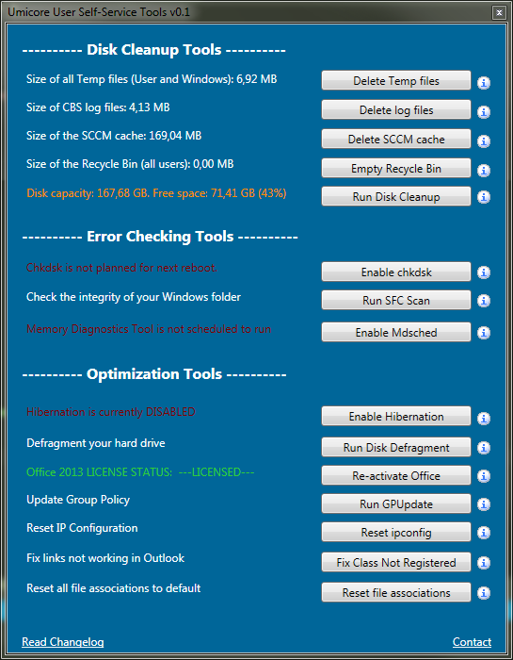
Example
“Umicore Toolbox”
Written for end users.
Various support functions.
No knowledge needed.
“Just click the button.”

Slide 160
No Lab
Live demo instead

Slide 161
20. Tips & Tricks
Some helpful closing thoughts
Notes:
Matthias

Slide 162
Use the -force
Sometimes, commands are reluctant to run.
For example: New-Item on existing file.
Error: The file ‘filename’ already exists.
Solution. New-Item filename.txt -type file -force.
Another example: Get-ChildItem does not display hidden files.
But it does when using -Force.
No confirmation! So be careful.

Slide 163
Readability
Shorter code is not always better.
Example: % is an alias for ForEach-Object.
But often, writing a full ForEach loop is much more understandable.
An IDE will discourage you from using aliases.
Use meaningful variable names.
$c = $a + $b VS $sum = $int1 + $int2
Document
But don’t use documentation as an excuse.
“Any fool can write code that a computer can understand. Good programmers write code that humans can understand.”

Slide 164
String manipulation
-Replace
Example: “192.168.34.12” -replace “34”, “15”
-Split
Example: “SomeatWeirdatString” -split “at”
-Contains VS -Like
Example: ‘this’ -contains ‘*his’ = False. ‘this’ -like ‘*his’ = True.
Like is for strings, contains is for checking collection membership.
IndexOf, ToLower, ToUpper, Trim,…

Slide 165
Date Manipulation
Get-Date
.Month, .Day, .Year,…
Arithmetic operations with AddDays, AddMonths, AddYears…
Example: (Get-Date).AddDays(-30) = “30 days ago”.

Slide 166
WMI
Windows Management Instrumentation
Internal database with A LOT of information about the computer.
Get-WmiObject
Example: Get-WmiObject Win32_Processor
Win32_BIOS, Win32_ComputerSystem, Win32_OperatingSystem,...
Full list: https://docs.microsoft.com/en-us/windows/desktop/CIMWin32Prov/win32-provider

Slide 167
Survey
Remember to fill out the survey:
https://forms.office.com/Pages/ResponsePage.aspx?id=tsPR7Ye-u0OS1HqRHFzuFxuX3eVGfXtFoOzIyh2dgltUOERVRjU3RFZZM0NDU0VFWDBNUUhEMFpSNy4u

Slide 168
Resources
https://docs.microsoft.com/en-us/powershell/
https://blogs.technet.microsoft.com/heyscriptingguy/2014/08/01/ive-got-a-powershell-secret-adding-a-gui-to-scripts/
https://foxdeploy.com/2015/04/10/part-i-creating-powershell-guis-in-minutes-using-visual-studio-a-new-hope/
https://docs.microsoft.com/en-us/dotnet/api/system.windows.controls?view=netframework-4.7.2
https://docs.microsoft.com/en-us/windows/desktop/CIMWin32Prov/win32-provider
https://github.com/Matthias-vdE
Notes:
Xavier en Matthias

Slide 169
Special Thanks
This presentation and all examples are based on the book “PowerShell in a Month of Lunches - Third Edition” by Manning Publishing (ISBN 9781617294167).
https://www.manning.com/books/learn-windows-powershell-in-a-month-of-lunches-third-edition
I have their written permission to use this book as source material.
Available via https://www.safaribooksonline.com/ (check with Toon for an account).

Slide 170
Good luck, and have fun using PowerShell!

